Slide 1
Data Mining
Lecture Notes for Chapter 4 & 8
Introduction to Data Mining
by
Tan, Steinbach, Kumar
© Tan,Steinbach, Kumar Introduction to Data Mining 4/18/2004 <number>

Slide 2
Machine Learning
Supervisado
  Clasificación (grupos).
  Regresión (continuo).
No supervisado (clustering)
  Aglomeración (número de cúmulos).
  Jerárquico (no requiere n.c.).

Slide 3
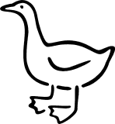
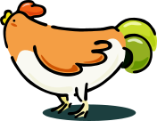
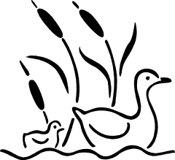

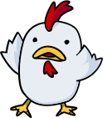

Nearest Neighbor Classifiers (KNN)
Basic idea:
  If it walks like a duck, quacks like a duck, then it’s probably a duck
Compute Distance
Test Record
Training Records
Choose k of the “nearest” records

Slide 4
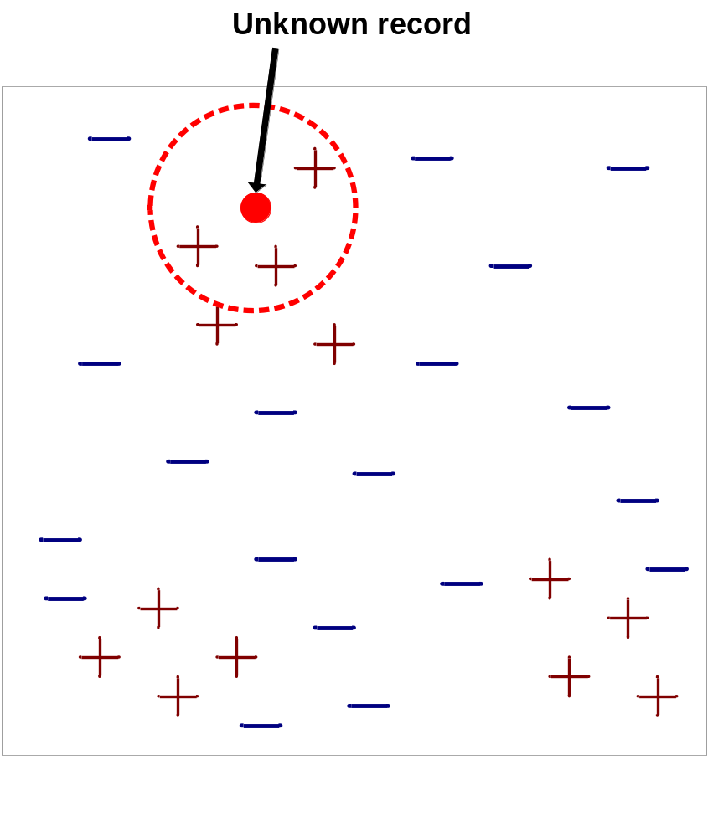
Nearest-Neighbor Classifiers
Requires three things
  The set of stored records
  Distance Metric to compute distance between records
  The value of k, the number of nearest neighbors to retrieve
To classify an unknown record:
  Compute distance to other training records
  Identify k nearest neighbors
  Use class labels of nearest neighbors to determine the class label of unknown record (e.g., by taking majority vote)

Slide 5

Definition of Nearest Neighbor
K-nearest neighbors of a record x are data points that have the k smallest distance to x

Slide 6
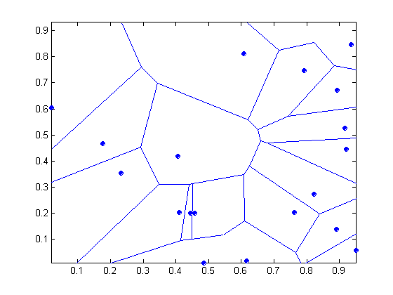
1 nearest-neighbor
Voronoi Diagram

Slide 7
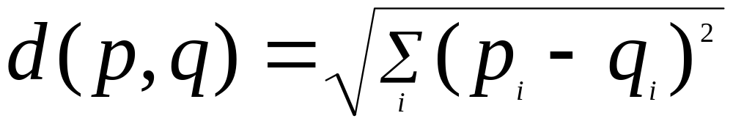
Nearest Neighbor Classification
Compute distance between two points:
  Euclidean distance
Determine the class from nearest neighbor list
  take the majority vote of class labels among the k-nearest neighbors
  Weigh the vote according to distance
    weight factor, w = 1/d²

Slide 8
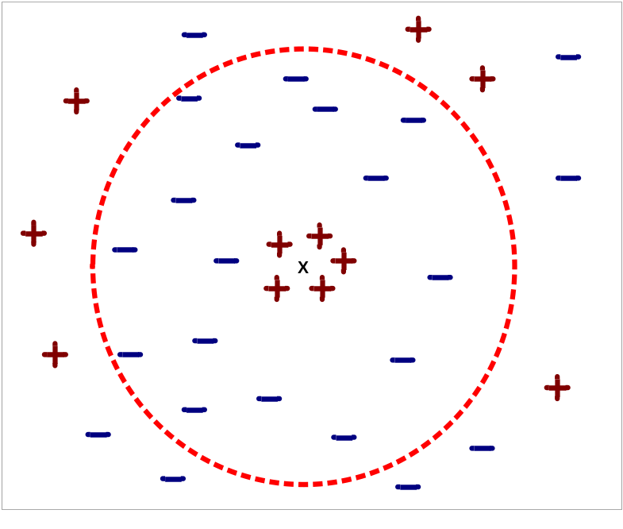
Nearest Neighbor Classification…
Choosing the value of k:
  If k is too small, sensitive to noise points
  If k is too large, neighborhood may include points from other classes

Slide 9
Nearest neighbor Classification…
k-NN classifiers are lazy learners
  It does not build models explicitly
  Unlike eager learners such as decision tree induction and rule-based systems
  Classifying unknown records are relatively expensive

Slide 10
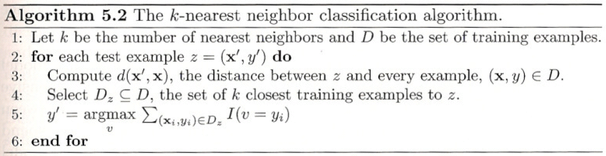
Pseudocode

Slide 11
Matlab example
You can pass Mdl to predict to label new measurements or crossval to cross-validate the classifier.
  load fisheriris
  X = meas;
  Y = species;
  (X is a numeric matrix that contains four measurements for 150 irises. Y is a cell array of character vectors that contains the corresponding iris species)
  Mdl = fitcknn(X,Y,'NumNeighbors',5)
  (Train a 5-nearest neighbor classifier)
  (You can pass Mdl to predict to label new measurements or crossval to cross-validate the classifier)

Slide 12
What is Cluster Analysis?
Finding groups of objects such that the objects in a group will be similar (or related) to one another and different from (or unrelated to) the objects in other groups
Inter-cluster distances are maximized
Intra-cluster distances are minimized

Slide 13
Clustering Algorithms
K-means and its variants
Hierarchical clustering
Density-based clustering
Self Organizing Maps.

Slide 14

K-means Clustering
Partitional clustering approach
Each cluster is associated with a centroid (center point)
Each point is assigned to the cluster with the closest centroid
Number of clusters, K, must be specified
The basic algorithm is very simple

Slide 15
K-means Clustering – Details
Initial centroids are often chosen randomly.
  Clusters produced vary from one run to another.
The centroid is (typically) the mean of the points in the cluster.
‘Closeness’ is measured by Euclidean distance, cosine similarity, correlation, etc.
K-means will converge for common similarity measures mentioned above.
Most of the convergence happens in the first few iterations.
  Often the stopping condition is changed to ‘Until relatively few points change clusters’
Complexity is O( n * K * I * d )
  n = number of points, K = number of clusters,
  I = number of iterations, d = number of attributes

Slide 16



Two different K-means Clusterings
Original Points
Optimal Clustering
Sub-optimal Clustering

Slide 17






Importance of Choosing Initial Centroids

Slide 18
Importance of Choosing Initial Centroids

Slide 19
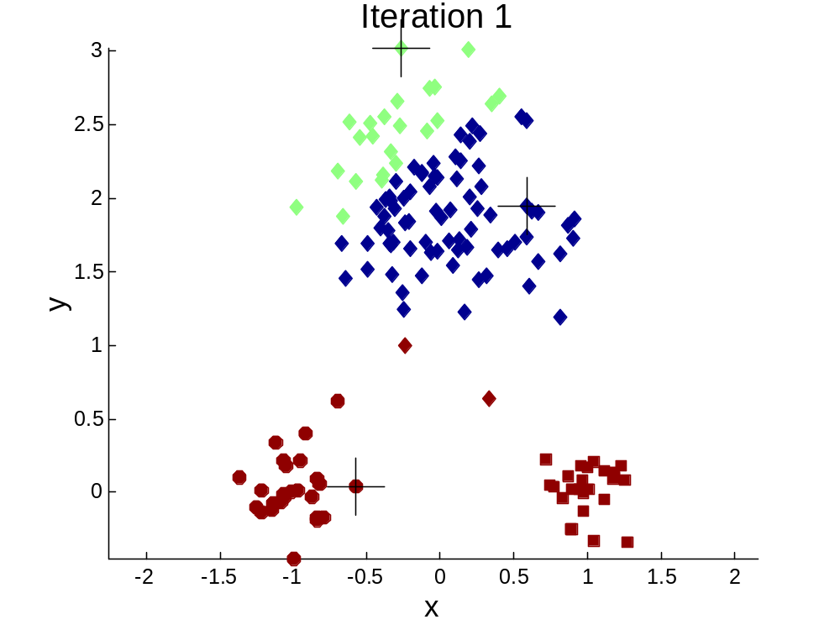


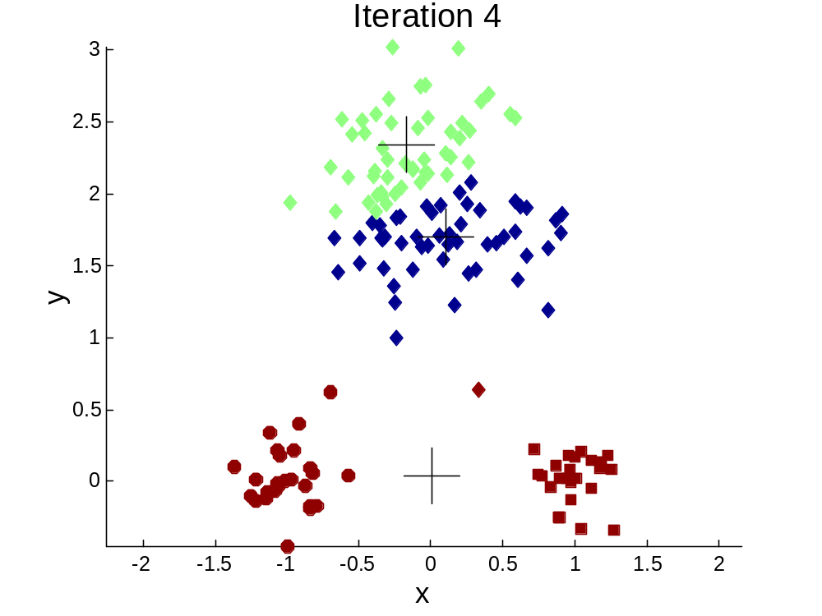
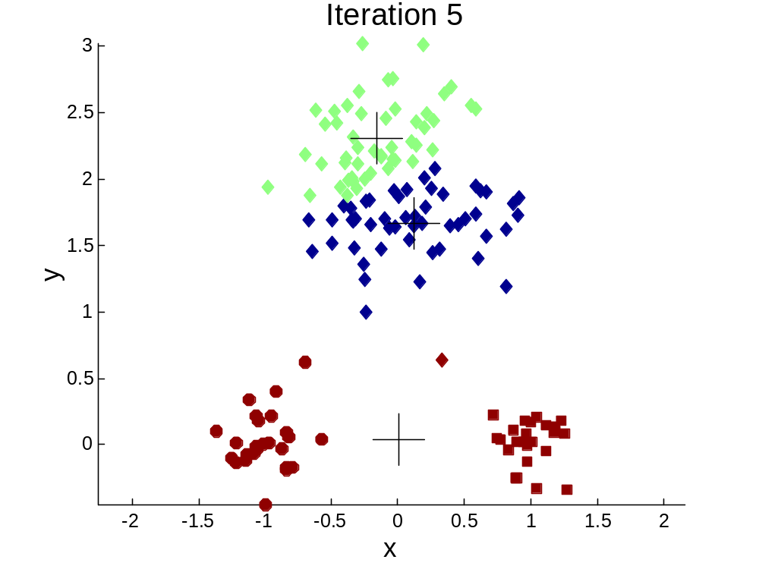
Importance of Choosing Initial Centroids …

Slide 20
Importance of Choosing Initial Centroids …

Slide 21
K-means in MATLAB
IDX = KMEANS(X, K) partitions the points in the N-by-P data matrix
X into K clusters. This partition minimizes the sum, over all
clusters, of the within-cluster sums of point-to-cluster-centroid
distances. Rows of X correspond to points, columns correspond to
variables. KMEANS returns an N-by-1 vector IDX containing the
cluster indices of each point. By default, KMEANS uses squared
Euclidean distances.

Slide 22
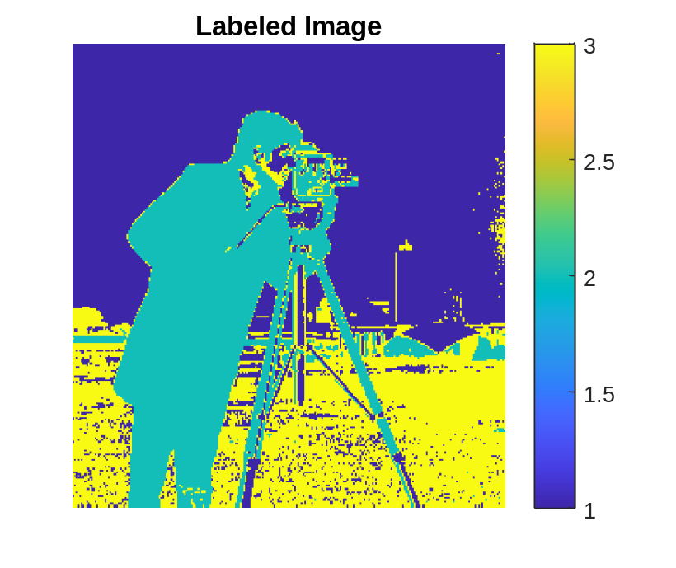

K-means in MATLAB
L = imsegkmeans(I,k) segments image I into k clusters by performing k-means clustering and returns the segmented labeled output in L.
I = imread('cameraman.tif');
imshow(I)
title('Original Image')
[L,Centers] = imsegkmeans(I,3);
imagesc(L)
colorbar
title('Labeled Image')
Try with colors image

